Slide 1




Nové možnosti rychlého a ultracitlivého panelového NGS testování mutací
ve tkáňových a tekutých biopsiích s využitím HANDLE® a ddCAP®
technologií přípravy knihoven
Marek Minárik

Slide 2
Disclosure information
Ownership in Elphogene, s.r.o. company
Owership in Carolina Biosystems, s.r.o. company

Slide 3

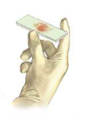


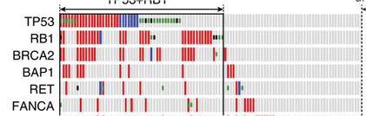



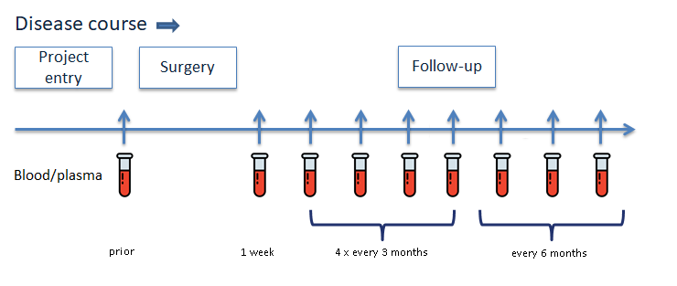
A mutation informed liquid biopsy
Tissue profiling
Mutation profile
Plasma profiling
Targeted detection
in plasma

Slide 4
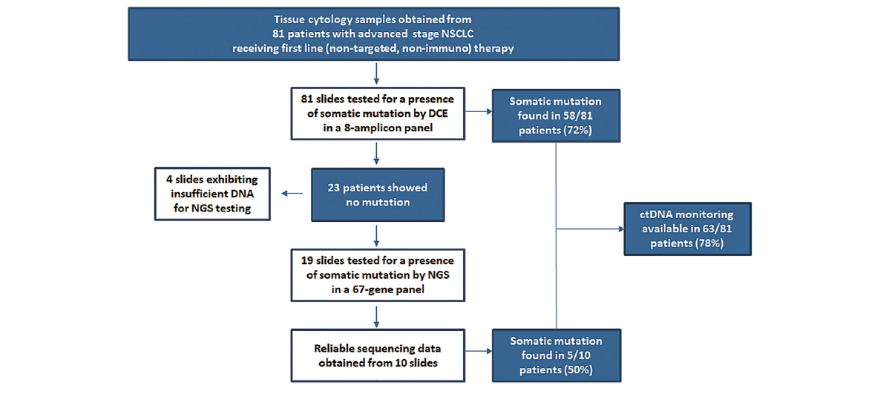
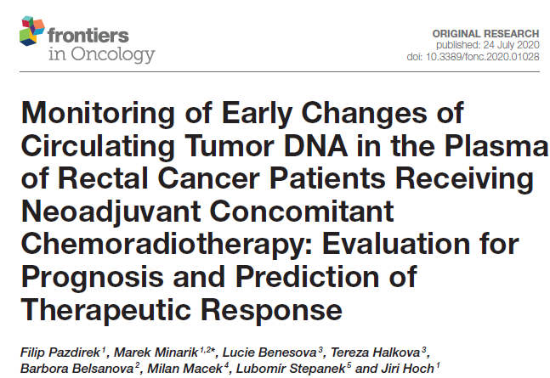
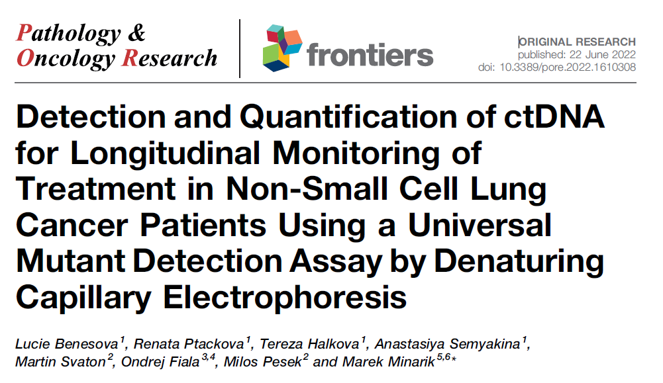
A two-tier approach
malý NGS panel
velký NGS panel

Slide 5
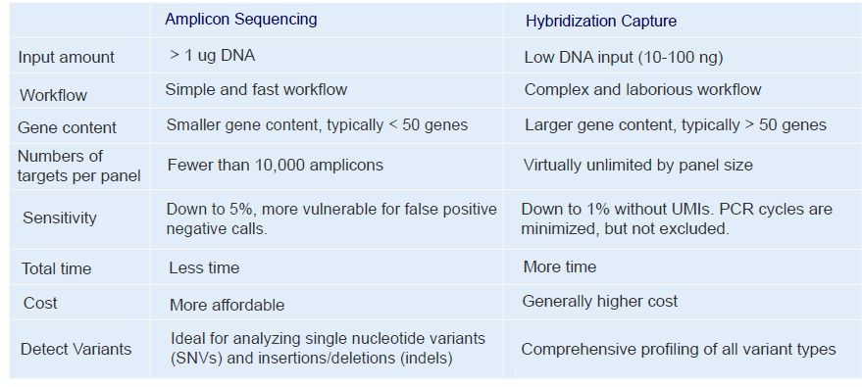
NGS (panel) sequencing technologies

Slide 6


Amplicon sequencing Hybridization capture sequencing:
HANDLE®
Halo-shape ANnealing and
Defer-Ligation Enrichment
ddCAP®
Dual-directional capture technology

Slide 7
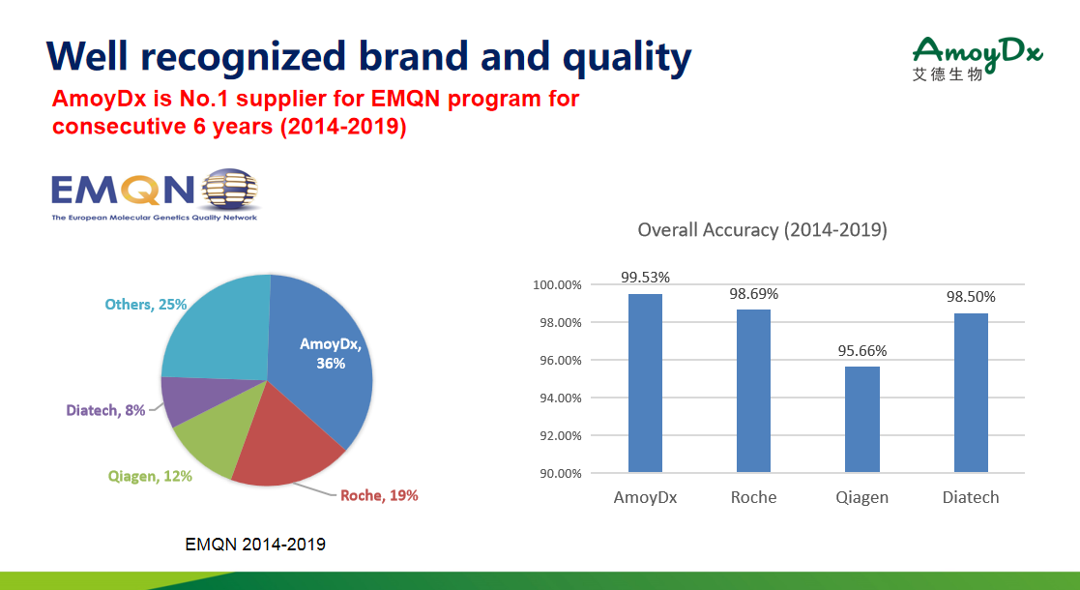

Slide 8
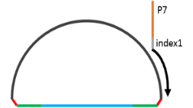
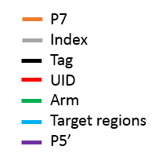
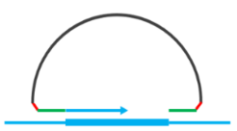
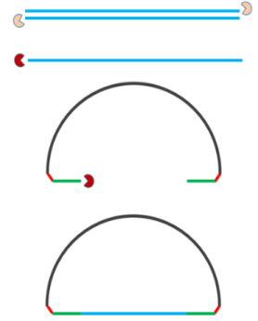
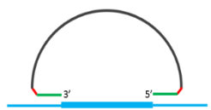

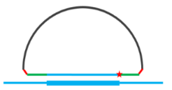
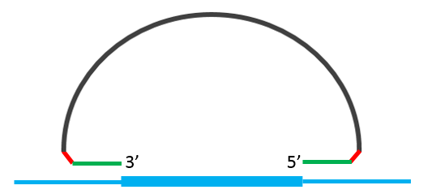


  Classic HANDLE® - Library Prep
Reverse Trasncription
~60min
Hybridization
~2h
Extension-Ligation
~10min
Digestion
~40min
PCR
~60min
Clean-up
~30min
Linker-Tag1
Linker-Tag2
Sensitivity: 1% MAF
mRNA
5’
3’
UMI 1
UMI 2
3’
5’
cDNA or gDNA
cDNA
Extension primer
Ligation primer
Simple workflow and low cost
One-Tube, Hands-on time < 1 h, total library construction time < 6 h
Easy to implement in local molecular lab
UMI (Unique Molecular Identifier): For error correction to improve sensitivity and accuracy.
8

Slide 9
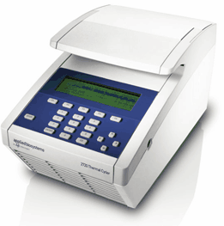
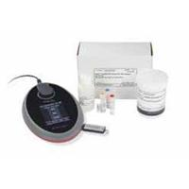




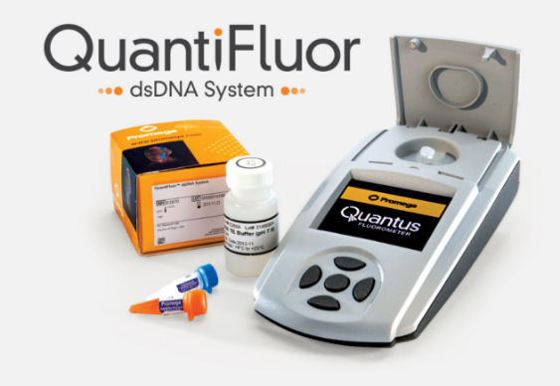
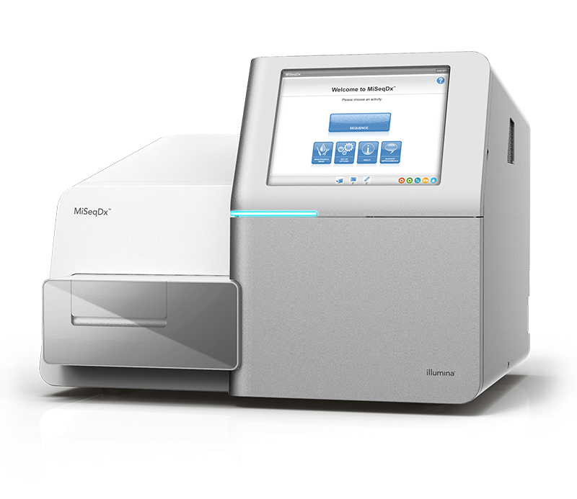
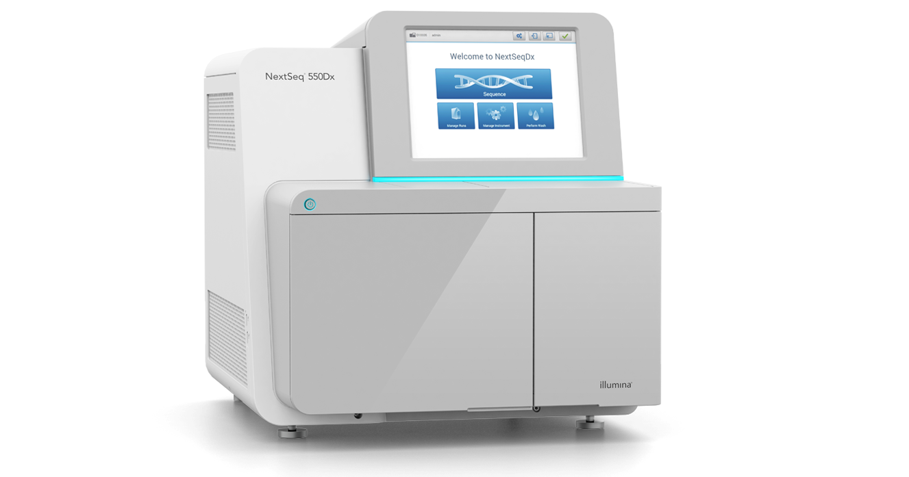

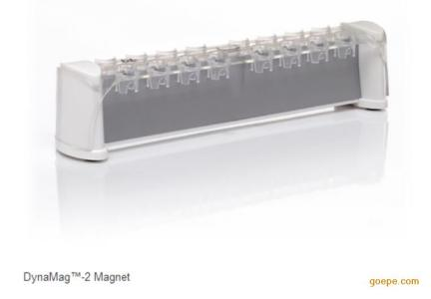


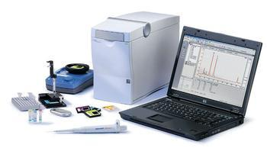
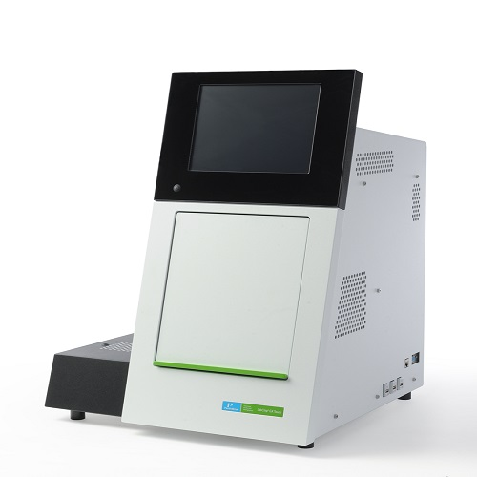
  Classic HANDLE® workflow
Day 1
Day 2
Day 2~3
Day 3
Step 3.
Sequencing
Step 4.
Bioinformatics data analysis
Step 1.
Nucleic acid extraction
Step 2.
Library preparation
TAT: ~5 h
TAT: ~6 h
TAT: ~30 h
TAT: ~1 h
or
ThermoCycler
Fluorometer
Miseq/MiseqDx
Nextseq 500/550Dx
Magnetic Stand
Fragment analysis
Extraction
Sample collection
Nucleic acid extraction
Quality control
Library Prep.
Sample barcoding
Target enrichment
Amplification/purification
Quality control
Sequencing
PE150 reads
Quality control
Bioinformatics
(Automatic data analysis)
Variant calling
Variant annotation
Quality control
9

Slide 10

  Classic HANDLE® NGS Panel Specs
Parameter | Specifications
Technology | HANDLE®
Target Regions | 40 genes and MSI
Alterations Detected | SNV, Indel, Fusion, CNV, MSI
Tumor Type | Pan-cancer
Sample Type | FFPE tumor tissue
NA Requirement | DNA: minimum 50 ng (Optimal 70 ng) / RNA: minimum 30 ng (Optimal 400 ng)
Limit of Detection (LoD) | 1% allele frequency; 5% allele frequency in non-core regions; minimum 20% tumor content
Recommended Data Amount per Sample | MiSeq/MiniSeq: 375 Mb/sample NextSeq: 1 Gb/sample
Sequencing Type | PE150
Sequencer | Illumina MiSeqDx, NextSeq 550Dx
TAT for Library Preparation | 6 h (hands-on time 1 h )
TAT from Sample to Report | 3 days
10

Slide 11
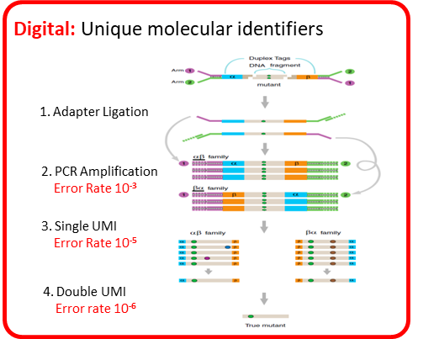
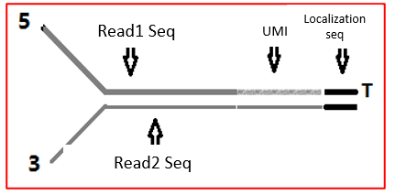
  Classic ddCAP® - Library Prep
Dual: probes targeting double strands
_{sense strand capture}
_{antisense strand capture}
11
Notes:
1.double UMI,reduce error

Slide 12
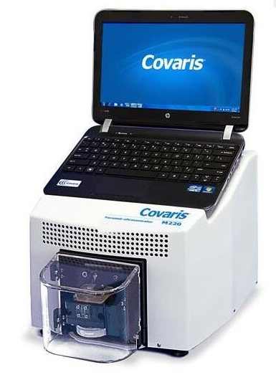
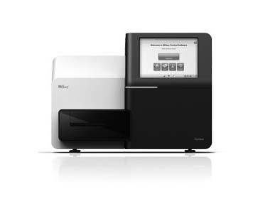
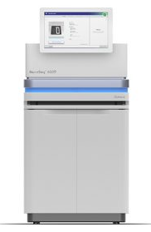
ddCap® Comprehensive Panel Workflow
Day 1
Day 2~3
Day 3~4
Day 5
Step 1.
Nucleic acid extraction
Step 2.
Library preparation
Step 3.
Sequencing
Step 4.
Data analysis
TAT: ~5 h
TAT: ~2 d
TAT: ~25-44 h
TAT: ~3-5 h
TAT: ~4 h
or
Ultrasonicator
(Covaris M220)
Fluorometer
ThermoCycler
Nextseq 500
Novaseq 6000
Magnetic Stand
Fragment analysis
Extraction
Sample collection
Nucleic acid extraction
Quality control
Library Prep.
Sample barcoding
Target enrichment
Amplification/purification
Quality control
Sequencing
PE150 reads
Quality control
Bioinformatics
(Automatic data analysis)
Variant calling
Variant annotation
Quality control
12

Slide 13
ddCAP® Comprehensive Panel – Specifications
Parameter | Specifications
Technology | ddCAP®
Target Regions | 128 genes and MSI
Alterations Detected | SNV, Indel, Fusion, CNV, SNP, MSI *
Tumor Type | Cross-tumor
Sample Type | FFPE tumor tissue, liquid biopsy
DNA Input | FFPE DNA: optimal 100 ng (minimum 50 ng) Plasma cfDNA: optimal 30 ng (minimum 10 ng)
Limit of Detection (LoD) | FFPE DNA: 5% allele frequency; 20% tumor content Plasma cfDNA: 0.5% allele frequency
Data Output per Sample | FFPE DNA: 1.5 Gb/sample Plasma cfDNA: 8 Gb/sample
Sequencing Type | PE150
Sequencer | Illumina NextSeq 500, NovaSeq 6000
TAT for Library Preparation | 2 d (hands-on time 4 h )
TAT from Sample to Report | 5 days
* CNV and MSI detection are for tissue sample only.
13

Slide 14
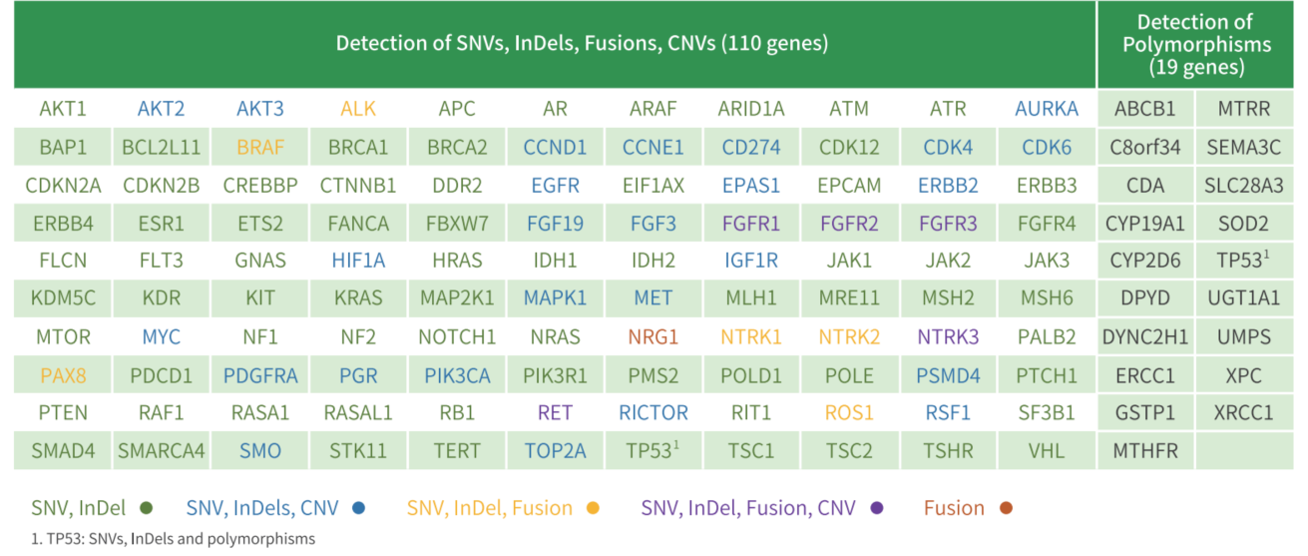
ddCAP® Comprehensive Panel – genes
14

Slide 15
Tkáň
Classic HANDLE® NGS kit (40 genů, 3 dny TAT, 24 reakcí) €175,- (Kč 4136,-)/vzorek
ddCAP® Comprehensive panel kit (129 genů, 5 dní TAT, 24 reakcí) €337,- (Kč 7755,-)/vzorek
Plasma
ddCAP® Comprehensive panel kit (129 genů, 5 dní TAT, 12 reakcí) €490,- (Kč 11633,-)/vzorek
15

Slide 16
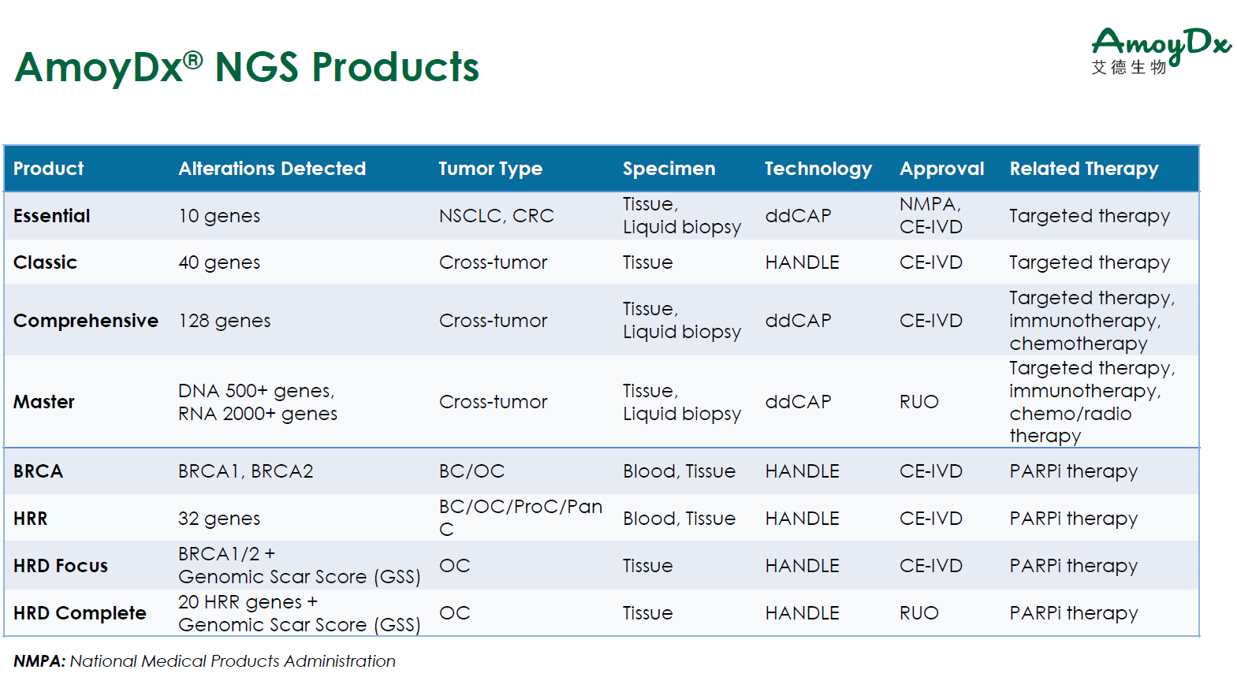
16

